Slide 1


Introduction to Drupal
Raghuram.N
Free Software Movement Karnataka
www.fsmk.org
fsmk-discuss@lists.fsmk.in

Slide 2
Introduction to Drupal
What is CMS?
Content Management System
It allows publishing, editing and modifying content as well as maintenance from a central interface
Its designed to simplify the complex task
Often used as blog software
Allows user to control and manage the Web content without technical training.

Slide 3
Introduction to Drupal
Introduction to Drupal
Famous free software CMS
Developed and maintained by community
Distributed under GNU General Public License
It used to develop web sites for photo galleries, video galleries, forums, community, e-learning, informational websites, social networking, internal communication and marketing

Slide 4
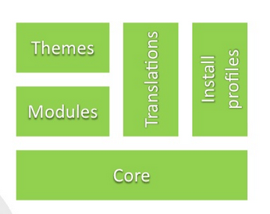
Introduction to Drupal
Drupal Architecture

Slide 5
Introduction to Drupal
Join Us to Spread Free Software
www.fsmk.org
fsmk-discuss@lists.fsmk.in
https://www.facebook.com/groups/151309701578334/

